Slide 1
Quality

Slide 2
Objectives
Explain the nature of quality
Explain the purpose of a quality review and how it is conducted
Describe the Capability Maturity Model (CMM)
Describe the mechanics of auditing a project
NB: please note relevance of material on configuration management

Slide 3
Quality management activities
Quality planning
  Select applicable procedures and standards for a particular project and modify these as required.
Quality assurance
  Establish organisational procedures and standards for quality.
Quality control
  Ensure that procedures and standards are followed by the software development team.
Quality management should be separate from project management to ensure independence.

Slide 4
Quality
The totality of features and characteristics of a product or service that bear on its ability to satisfy stated or implied needs.
I.e. a product should meet its specifications.
  The software product should deliver the required functionality (functional requirements) with the required quality attributes (non–functional) requirements

Slide 5
Quality with respect to software systems
This is usually a problem for software systems
  There is often tension between between customer quality requirements (viz. efficiency, reliability, etc) and developer quality requirements (viz. maintainability, reusability, etc).
  It is difficult to specify some quality requirements in an unambiguous way.
  Software specifications are usually incomplete and often inconsistent.
It is not possible to wait for everything to be known before putting in place measures to ensure quality in our product
Quality attributes are frequently conflicting and increase development costs, so there is a need for weighting and balancing of concerns.

Slide 6
Monitoring quality
Quality is monitored by reviewing and testing what has been produced.
A quality review is a review of the quality of some part of the work.
  Earlier in the project there will have been quality reviews of the requirements, the estimates and the plan.
  Once in execution there will be reviews of the work in progress and testing of finished products.
A prime example is the design review, a necessary step in all projects that have a design phase.

Slide 7
Design Review
A design review is a formal, documented, comprehensive and systematic examination of a design to evaluate the design requirements and the capability of the design to meet these requirements and to identify and propose solutions.

Slide 8
Quality attributes for a product
For quality software it is necessary to have a number of attributes beyond meeting functionality requirements:
  Efficiency: Software should not be wasteful with system resources such as memory, CPU time, disk space etc. Response times should be appropriate.
  Usability: ease of use, i.e. software must be usable by the users for which it was designed.
  Dependability: reliability, availability, security, safety, etc.
  Maintainability: software must evolve to meet changing needs. It costs more to maintain software than to develop it.

Slide 9
Other quality attributes
Resilience
Robustness
Understandability
Testability
Adaptability
Modularity
Simplicity
Portability
Reusability
Learnability

Slide 10
Software metric
Any type of measurement which relates to a software system, process or related documentation
  Lines of code in a program, the Fog index, number of person-days required to develop a component.
Allow the software and the software process to
be quantified.
May be used to predict product attributes or to control the software process.
Product metrics can be used for general predictions or to identify anomalous components.
Assumptions
  A software property can be measured.
  A relationship exists between what we can measure and what we want to know. We can only measure internal attributes but are often more interested in external software attributes.

Slide 11
Aspects of dependability
Reliability: The probability of system operation without failure over a specified time in a certain environment for a particular purpose.
Availability: The probability that a system will be operational and able to deliver a requested service at a particular point in time.
Safety: Can the system operate without danger of causing human injury or death and without damage to the system’s environment. (Very significant with embedded systems).
Security: A system’s ability to protect itself from accidental or deliberate external attack.

Slide 12
Dependability and critical systems
For critical systems, it is usually the case that the most important system property is the dependability of the system
Types of critical systems:
  Safety–critical system – a system whose failure may result in injury, loss of life or major environment damage
    e.g. an insulin delivery system
  Mission-critical system – a system whose failure may result in the failure of some goal-directed activity
    e.g. a navigational system for a space aircraft
  Business-critical system – a system whose failure may result in the failure of the business using the system
    e.g. a customer account system in a bank

Slide 13
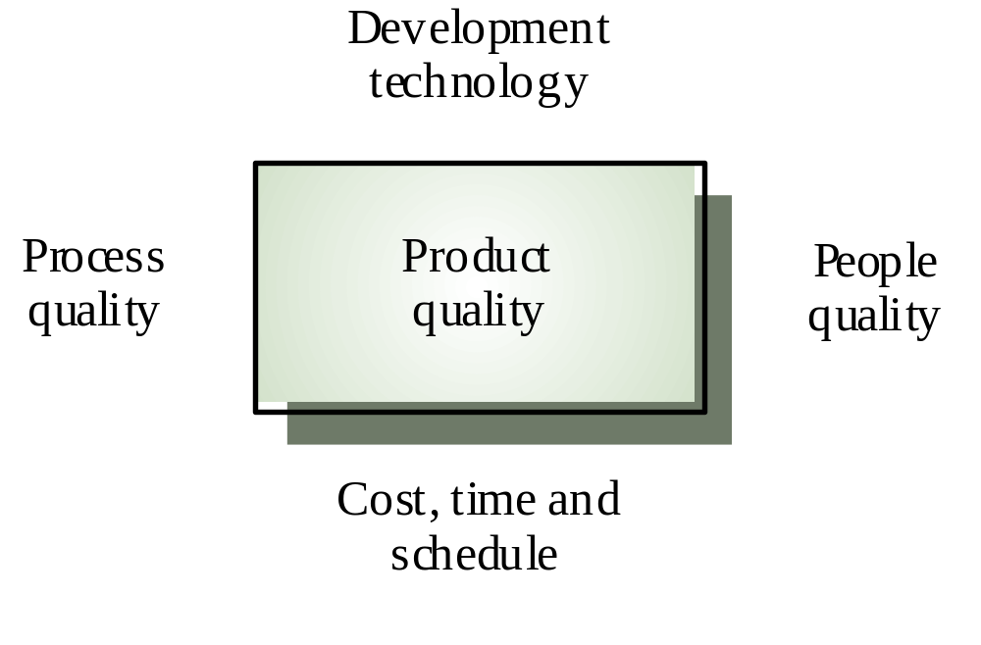
Product Quality Factors

Slide 14
Product Quality Metrics
Intrinsic product quality is usually measured by the number of “bugs” (functional defects) in the software or by how long the software can run before encountering a “crash”. Two examples are:
  Mean time to failure:- time between failures
  Defect density:- defects relative to the software size (lines of code, function points, etc). I.e. number of defects over the opportunities for error (OFE) during a specific time frame.

Slide 15
Product Quality Metrics
Customer Satisfaction Metrics:
  Customer satisfaction:- Often measured via a five point scale
  Satisfaction with the overall quality of a product and its specific aspects/dimensions is usually obtained through various methods of customer surveys. For instance, the specific parameters of customer satisfaction monitored by IBM include: capability, functionality, usability, performance, reliability, installability, maintainability, documentation/information, service, and overall)
Very satisfied
Satisfied
Neutral
Dissatisfied
Very dissatisfied

Slide 16
Product Quality Metrics
  Customer problems: measures the problems that customers encounter when using the product.
    For the defect rate metric, the numerator is the number of valid defects. However, from the customer’s viewpoint, all problems they encounter while using the software product, not just valid defects are problems with the software.
    Problems that are not valid defects may be usability problems, unclear documentation, etc.

Slide 17
Process quality
  A good process is usually required to produce a good product
  For manufactured goods, process is the principal quality determinant
  For design-based activity (like software development), other factors are also involved especially the capabilities of the designers
  For large projects with ‘average’ capabilities, the development process determines product quality
People quality
  For small projects, the capabilities of the developers is the main determinant
  Corollary: you need lower quality people (and higher quality process) in larger projects?
  Project Size x People Quality = Constant ?
Development technology
  Is particularly significant for small projects
Budget and schedule
  In all projects, if an unrealistic schedule is imposed then product quality will suffer

Slide 18
ISO Approach
Quality Planning: identifying which quality standards are relevant to the project and determining how to satisfy them.
Quality Assurance: evaluating overall project performance on a regular basis to provide confidence that the project will satisfy the relevant quality standards.
Quality Control: monitoring specific project results to determine if they comply with relevant quality standards and identifying ways to eliminate causes of unsatisfactory performance.

Slide 19
There are a number of standards and approaches to quality management. Among the more prominent are the following:
  ISO standards, i,.e. ISO 9000 and 10000 series of standards and guidelines.
  Proprietary processes such as those recommended by Deming, Juran, Crosby, and others.
  Non-proprietary approaches such as Total Quality Management (TQM), Continuous Improvement, and others.

Slide 20
Quality Planning
Identifying which quality standards are relevant to the project and determining how to satisfy them.
A key facilitating process during project planning and should be performed regularly and in parallel with other project planning processes.

Slide 21
Quality assurance and standards
Standards are the key to effective quality management.
They may be international, national, organizational or project standards.
Product standards define characteristics that all components should exhibit e.g. a common programming style.
Process standards define how the software process should be enacted.

Slide 22
Importance of standards
Encapsulation of best practice- avoids
repetition of past mistakes.
They are a framework for quality assurance processes - they involve checking compliance to standards.
They provide continuity - new staff can understand the organisation by understanding the standards that are used.

Slide 23
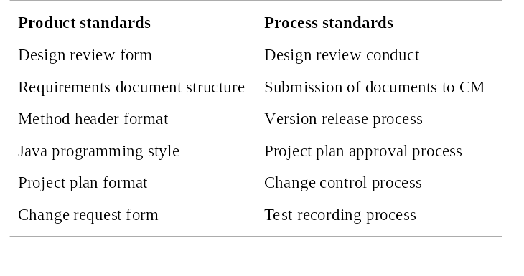
Product and process standards

Slide 24
Problems with standards
They may not be seen as relevant and up-to-date by software engineers.
They often involve too much bureaucratic form filling.
If they are unsupported by software tools, tedious manual work is often involved to maintain the documentation associated with the standards.

Slide 25
Standards development
Involve practitioners in development. Engineers should understand the rationale underlying a standard.
Review standards and their usage regularly.
Standards can quickly become outdated and this reduces their credibility amongst practitioners.
Detailed standards should have associated tool
support. Excessive clerical work is the most
significant complaint against standards.

Slide 26
Process and product quality
The quality of a developed product is influenced by the quality of the production process.
This is important in software development as some product quality attributes are hard to assess.
However, there is a very complex and poorly understood relationship between software processes and product quality.

Slide 27
Process-based quality
There is a straightforward link between process and product in manufactured goods.
More complex for software because:
  The application of individual skills and experience is particularly imporant in software development;
  External factors such as the novelty of an application or the need for an accelerated development schedule may impair product quality.
Care must be taken not to impose inappropriate process standards - these could reduce rather than improve the product quality.

Slide 28
Practical process quality
Define process standards such as how reviews should be conducted, configuration
management, etc.
Monitor the development process to ensure
that standards are being followed.
Report on the process to project management and software procurer.
Don’t use inappropriate practices simply because standards have been established.

Slide 29
ISO 9000
An international set of standards for quality management.
Applicable to a range of organisations from manufacturing to service industries.
ISO 9001 applicable to organisations which design, develop and maintain products.
ISO 9001 is a generic model of the quality process that must be instantiated for each organisation using the standard.

Slide 30
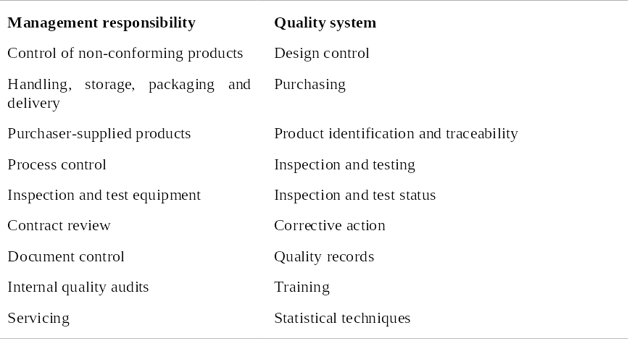
ISO 9001

Slide 31
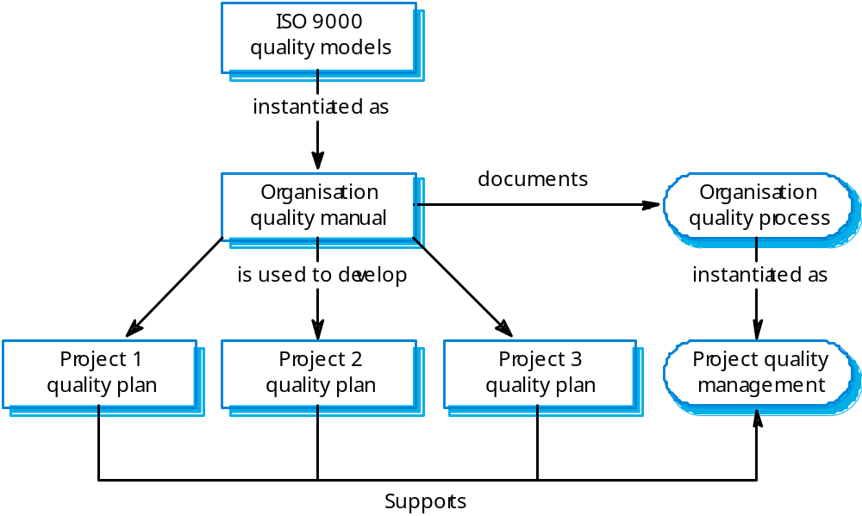
ISO 9000 and quality management

Slide 32
Documentation standards
Particularly important - documents are the tangible manifestation of the software.
Documentation process standards
  Concerned with how documents should be developed, validated and maintained.
Document standards
  Concerned with document contents, structure, and appearance.
Document interchange standards
  Concerned with the compatibility of electronic documents.

Slide 33
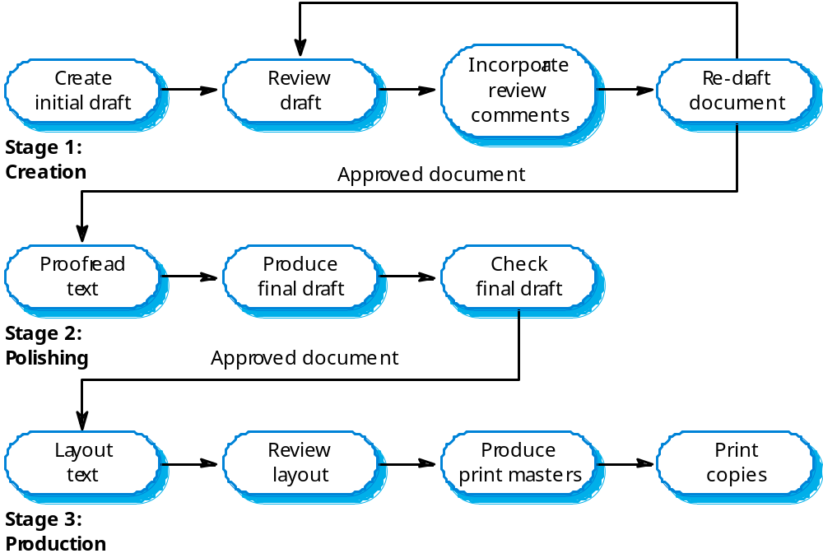
Documentation process

Slide 34
Document interchange standards
Interchange standards allow electronic documents to be exchanged, mailed, etc.
Documents are produced using different systems and on different computers. Even when standard tools are used, standards are needed to define conventions for their use e.g. use of style sheets and macros.
Need for archiving. The lifetime of word processing systems may be much less than the lifetime of the software being documented. An archiving standard may be defined to ensure that the document can be accessed in future.

Slide 35
Quality plans
Quality plan structure
  Product introduction;
  Product plans;
  Process descriptions;
  Quality goals;
  Risks and risk management.
Quality plans should be short, succinct documents
  If they are too long, no-one will read them.

Slide 36
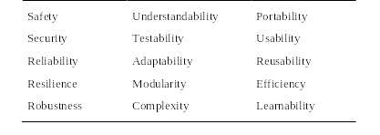
Software quality attributes

Slide 37
Quality control
This involves checking the software development process to ensure that procedures and standards are being followed.
There are two approaches to quality control
  Quality reviews;
  Automated software assessment and software measurement.

Slide 38
Quality reviews
This is the principal method of validating the quality of a process or of a product.
A group examines part or all of a process or system and its documentation to find potential problems.
There are different types of review with different objectives
  Inspections for defect removal (product);
  Reviews for progress assessment (product and process);
  Quality reviews (product and standards).

Slide 39
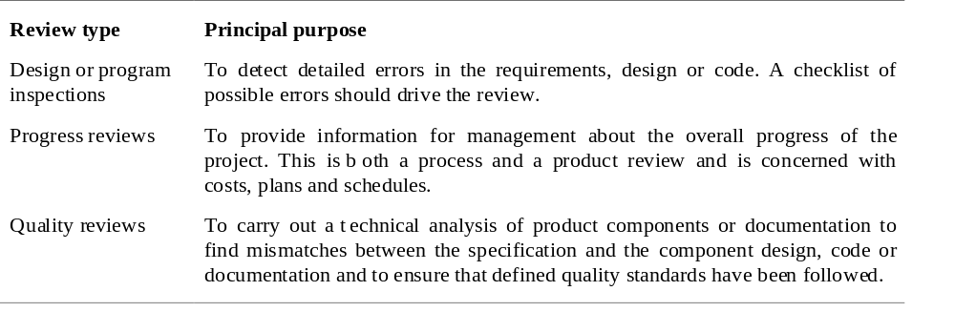
Types of review

Slide 40
Quality reviews
A group of people carefully examine part or all of a software system and its associated documentation.
Code, designs, specifications, test plans, standards, etc. can all be reviewed.
Software or documents may be 'signed off' at a review which signifies that progress to the next development stage has been approved by management.

Slide 41
Review functions
Quality function - they are part of the general quality management process.
Project management function - they provide information for project managers.
Training and communication function - product knowledge is passed between development team members.

Slide 42
Quality reviews
The objective is the discovery of system defects and inconsistencies.
Any documents produced in the process may be reviewed.
Review teams should be relatively small and reviews should be fairly short.
Records should always be maintained of quality reviews.

Slide 43
Review results
Comments made during the review should be
classified
  No action. No change to the software or documentation is
  required;
  Refer for repair. Designer or programmer should correct an identified fault;
  Reconsider overall design. The problem identified in the
  review impacts other parts of the design. Some overall
  judgement must be made about the most cost-effective way of solving the problem;
Requirements and specification errors may
have to be referred to the client.

Slide 44
Quality Assurance
Inputs
  Quality management plan
  Results of quality control measurements
  Operational Definitions
Tools and Techniques
  Quality planning tools and techniques
  Quality audits
Outputs
  Quality improvement

Slide 45
Quality Control
Inputs
  Work results
  Quality management plan
  Operational definitions
  Checklists
Tools and Techniques
  Inspection
  Control charts
  Pareto diagrams
  Statistical sampling
  Flowcharting
  Trend analysis
Outputs
  Quality improvement
  Acceptance decisions
  Rework
  Completed checklists
  Process adjustments

Slide 46
Capability Maturity Model (CMM)
Historical: has since evolved into CMM-I
SEI Software Engineering Institute

Slide 47
Characterizing the Maturity of Software Life Cycle Models
CMM uses the following five levels to characterize the maturity of an organization in terms of its commitment to processes.
  Initial
  Repeatable
  Defined
  Managed
  Optimized

Slide 48
Five Levels of Software Process Maturity
Continuously
Improving
Process
5. Optimizing
Predictable
Process
4. Managed
Standard
Consistent
Process
3. Defined
Disciplined
Process
2. Repeatable
1. Initial

Slide 49
Key Process Areas (KPAs)
A set of key process areas (KPA) has been defined by the Software Engineering Institute (SEI).
To achieve a specific level of maturity, the organization must demonstrate that it addresses all the key process areas defined for that level.

Slide 50
Mapping Process Maturity Level and Key Process Areas
Maturity Level | Key Process Area
Initial | Not applicable
2. Repeatable | Focus: Establish basic project management controls. Requirements management: Requirements are baselined in a project agreement and maintained during a project. Project planning and tracking: A software project management plan is established at the beginning of the project and is tracked during the project. Subcontractor management: The organization selects and effectively manages qualified software subcontractors. Quality assurance management: All deliverables and process activities are reviewed and audited to verify that they comply with standards and guidelines adopted by the organization. Configuration management: A set of configuration management items is defined and maintained throughout the entire project.

Slide 51
Mapping Process Maturity Level and Key Process Areas
Maturity Level | Key Process Area
3. Defined | Focus: Establish an infrastructure that allows a single effective software lifecycle model across all projects. Organization process focus: The organization has a permanent team to constantly maintain and improve the software life cycle model. Organization process definition: A standard software life cycle model is used for all projects in the organization. A database is used for software lifecycle related information and documentation. Training program: The organization identifies the need for training for specific projects and develops training programmes. Integrated software management: Each project team can tailor its specific process from the standard process. Software product engineering: The software is built in accordance with the defined software life cycle, methods and tools. Intergroup coordination: The project teams interact with each other to address requirements and issues. Peer reviews: Developers examine each other’s deliverables to identify potential defects and areas where changes are needed.

Slide 52
Mapping Process Maturity Level and Key Process Areas
Maturity Level | Key Process Area
4. Managed | Focus: Quantitative understanding of the software life cycle process and deliverables. Quantitative process management: Productivity and quality metrics are defined and constantly measured across the project. It is critical that these data are not immediately used during the project, in particular to assess the performance of the developers, but are stored in a database to allow for comparison with other projects. Quality management: The organization has defined a set of quality goals for software products. It monitors and adjusts the goals and products to deliver high quality products to the user.

Slide 53
Mapping Process Maturity Level and Key Process Areas
Maturity Level | Key Process Area
5. Optimized | Focus: Keep track of technology and process changes that may cause changes in the system model or deliverables, even during a project. Defect prevention: Failures in past projects are analyzed, using data from the metrics database. If necessary, specific actions are taken to prevent those defects from occurring again. Technology change management: Technology enablers and innovations are constantly investigated and shared throughout the organization. Process change management: The software process is constantly refined and changed to deal with inefficiencies identified by the software process metrics. Constant change is the norm, not the exception.

Slide 54
Metrics
Many software metrics have been proposed, such as the number of lines of source code, the number of branching points, the number of variables and operators, and the number of functional requirements.
Metrics can also measure attributes of the process, such as deviations from the schedule, resources expended, and number of participants leaving prematurely.
  Measuring financial status
  Measuring technical progress
  Measuring stability
  Measuring modularity
  Measuring maturity

Slide 55
Metrics
Measuring Financial Status
  Earned Value
Measuring Technical Progress
  Especially challenging in software development projects in determining exactly what tasks have actually been accomplished. Requires size metrics for each time.
    For the development team this can include number of lines of source code under baseline, or the number of closed change requests.
    For the testing team, this can include the number of defects found or the number of open change requests.
    For the architecture team this can include the number of critical uses cases that have been demonstrated to work.
  Size metrics, however, must be viewed in combination with quality metrics to ensure that participants are not locally optimizing their numbers.

Slide 56
Metrics
Measuring stability
  Once an initial version of the system is baselined, change requests are issued to control and track changes to the baseline.
  Measuring the rate of new change requests corresponding to defects in the system indicates how stable the system becomes over time.
  Measuring the rate of change requests to the requirements similarly indicates how stable the requirements have become in the view of the client.
  If work completion indicates that the project is almost finished, but the rate of change requests is still high, the project might not be achieving its quality goals.

Slide 57
Metrics
Measuring modularity
  Breakage is a measure of the impact of a change on the baseline (which can be measured in terms of lines of code, number of files, function points, or any size metric that is appropriate in the context of the project).
  It is expected that early changes affect more source code than later ones, as the architecture should become more modular over the project time.
  Measuring breakage can encourage this trend and make visible early any architectural issues (e.g., identifying specific types of changes that yield high breakage).
  Increasing breakage indicates a degrading modularity over the lifetime of the project, probably resulting from an inadequate architecture or specific nonfunctional requirements that are difficult to meet.

Slide 58
Metrics
Measuring maturity
  Mean time between failures measures the time between discovered defects during testing.
  As the project nears delivery, the number of discovered defects should decrease, indicating an increasing maturity of the product.
  A decreasing maturity can indicate that developers are under pressure to address open change requests and do not pay sufficient attention to quality.
  Decreasing maturity can also result from lack of stability.

Slide 59
category | Examples | How Defined?
Project Performance | Budget Performance | Actual expenditures versus targets
 | Schedule Performance | Rate of progress with milestone achievements
 | Earned Value Performance | Value earned for milestones achieved versus budget set for work to be performed and actual expenditure
 | Technical Performance | Indicators such as Requirements growth and size growth
Process Performance | Rework rate | Number of times it takes to get it right
 | Defect rates | Number of defects discovered and removed as a function of time

Slide 60
category | Examples | How Defined?
Product Quality | Product Complexity | Cyclomatic number or some similar metric
 | Defect Density | Number of defects as a function of size
Personnel Performance | Personal Productivity | Individual output as a function of the inputs used to generate them
Organizational Performance | Process maturity | SEI rating
 | Product Quality | Compliant rate
 | Productivity | Group output as a function of the inputs used to generate them
Enterprise performance | Profitability | Price to earnings ratio
 | Return on equity | Earnings as a function of the capital used to generate it.
 | Cost of sales | Money spent on sales as a function of revenue earned

Slide 61
Key Process Areas for Level 2: Repeatable
Requirements Management
  Goal 1: System requirements allocated to software are controlled to establish a baseline for software engineering and management use.
  Goal 2: Software plans, products and activities are kept consistent with the system requirements allocated to software.
Software Project Planning
  Goal 1: Software estimates are documented for use in planning and tracking the software project.
  Goal 2: Software project activities and commitments are planned and documented.
  Goal 3: Affected groups and individuals agree to their commitments related to the software project.

Slide 62
Key Process Areas for Level 2: Repeatable
Software Project Tracking and Oversight
  Goal 1: Actual results and performance are tracked against the software plans.
  Goal 2: Corrective actions are taken and managed to closure when actual results and performance deviate significantly from the software plans.
  Goal 3: Changes to software commitments are agreed to by the affected groups and individuals.
Software Subcontract Management
  Goal 1: The prime contractor selects qualified software subcontractors.
  Goal 2: The prime contractor and the software subcontractor agree to their commitments to each other.
  Goal 3: The prime contractor and the software subcontractor maintain ongoing communications.
  Goal 4: The prime contractor tracks the software subcontractor’s actual results and performance against its commitments.

Slide 63
Key Process Areas for Level 2: Repeatable
Software Quality Assurance
  Goal 1: Software quality assurance activities are planned.
  Goal 2: Adherence of software products and activities to the applicable standards, procedures and requirements is verified objectively.
  Goal 3: Affected groups and individuals are informed or software quality assurance activities and results.
  Goal 4: Noncompliance issues that cannot be resolved within the software project are addressed by senior management.
Software Configuration Management
  Goal 1: Software configuration management activities are planned.
  Goal 2: Selected software work products are indentified, controlled and available.
  Goal 3: Changed to identified software work products are controlled.
  Goal 4: Affected groups and individuals are informed of the status and content of software baselines.

Slide 64
Key Process Areas for Level 3: Defined
Organization Process Focus
  Goal 1: Software process development and improvement activities are coordinated across the organization.
  Goal 2: The strengths and weaknesses of the software processes used are identified relative to a process standard.
  Goal 3: Organization-level process development and improvement activities are planned.
Organization Process Definition
  Goal 1: A standard software process model for the organization is developed and maintained.
  Goal 2: Information related to the use of the organization’s standard software process model by its software projects is collected, reviewed and made available.

Slide 65
Key Process Areas for Level 3: Defined
Training Program
  Goal 1: Training activities are planned.
  Goal 2: Training for developing skills and knowledge to perform software management and technical roles is provided.
  Goal 3: Individuals in the software engineering group and software-related groups receive the training necessary to perform their roles.
Integrated Software Management
  Goal 1: The project’s defined software process model is a tailored version of the organization’s standard software process model
  Goal 2: The project is planned and managed according to the project’s defined software process.

Slide 66
Key Process Areas for Level 3: Defined
Software Product Engineering
  Goal 1: The software engineering tasks are defined, integrated, and consistently performed to produce the software.
  Goal 2: Software work products are kept consistent with each other.
Intergroup Coordination
  Goal 1: The customer’s requirements are agreed to by all affected groups.
  Goal 2: The commitments between the engineering groups are agreed to by the affected groups.
  Goal 3: The engineering groups identify, track and resolve intergroup issues.
Peer Reviews
  Goal 1: Peer review activities are planned.
  Goal 2: Defects in the software work products are identified and removed.

Slide 67
Key Process Areas for Level 4: Managed
Quantitative Process Management
  Goal 1: The quantitative process management activities are planned.
  Goal 2: The process performance of the project’s defined software process is controlled quantitatively.
  Goal 3: The process capability of the organization’s standard software process is known in quantitative terms.
Software Quality Management
  Goal 1: The project’s software quality management activities are planned.
  Goal 2: Measurable goals for software product quality and their priorities are defined.
  Goal 3: Actual progress toward achieving the quality goals for the software products is quantified and managed

Slide 68
Key Process Areas for Level 5: Optimizing
Defect Prevention
  Goal 1: Defect prevention activities are planned.
  Goal 2: Common causes of defects are sought out and identified.
  Goal 3: Common causes of defects are prioritized and systematically eliminated.
Technology Change Management
  Goal 1: Incorporation of technology changes are planned.
  Goal 2: New technologies are evaluated to determine their effect on quality and productivity.
  Goal 3: Appropriate new technologies are transferred into normal practice across the organization
Process Change Management
  Goal 1: Continuous process improvement is planned.
  Goal 2: Participation in the organization’s software process model improvement activities is organization wide.
  Goal 3: The organization’s standard software process model and the project’s defined software processes are improved continuously.

Slide 69
Project Audits

Slide 70
What is an audit?
Independent review and examination of records and activities to assess the adequacy of system controls, to ensure compliance with established policies and operational procedures, and to recommend necessary changes in controls, policies, or procedures.
Can be applied to almost anything that is auditable: financial audit, quality audit, project audit, etc.
It is expected that the opinion of the auditor as expressed in the final audit report will be objective.

Slide 71
Auditing a project
The main aim of an audit is to reduce uncertainty.
An audit is an official examination. In project work, we are concerned with two types of audit:
  A general project audit to determine the status of the project
  A quality audit to determine how closely the processes adhere to standards and how closely the products match the user’s requirements.

Slide 72
Who does the auditing?
There are two types of auditors:
  Internal auditor – These are employees of a company who assess and evaluate its system of internal controls. To maintain independence they present their reports directory to the Board of directors or top management.
  External auditor – These are independent staff assigned to assess and evaluate an organization’s systems of internal control or to perform other agreed upon evaluations. They are called upon from outside the company.

Slide 73
Who does the auditing?
Auditors must be independent from and external to the group being audited so that there can be no accusations of bias or temptation to justify the status quo. Their function is to discover the truth.
Usually a small team is required, typically three or four skilled people.
Although auditors must be external to the group being audited they need not be external to the organization. Audits can be either internal or external.

Slide 74
Project audit
A project audit, in contrast to a financial audit, is an appraisal of the technical status of a project, or a specified part of a project, and will most usually be performed during a project rather than at its end.
A project audit is performed by an independent auditing body external to the project team, and is conducted in a formal and systematic manner.

Slide 75
Project audit
Purpose of a project audit
  Determine if the project is on-track or not.
  If the project is off-track, determine why this is the case and offer specific advice on how to get it back on track or advice on whether the project ought to be cancelled.
  Determine whether the causes of the project issues are systemic and ascertain how these can be avoided (obviated) in the future.

Slide 76
Aspects to cover
Project Management deliverables
All project deliverables
Subcontractor contracts
Etc…

Slide 77
Quality audit
Usually carried out for the specific purpose of checking that quality standards are being applied when:
  A quality problem is suspected, and a manager would appreciate a fresh look at the area by an impartial observer
  A company’s business requirements are such that it must be registered as conforming to an external standard. This may be to conform with the client’s requirements, such as conditions for tendering for government contracts. In such cases internal audits are necessary to prepare the company for audits by the registering body.

Slide 78
When to audit
Usually an audit is a short, sharp exercise which might in some cases take as little as a day, but typically takes 2-3 weeks.
Audits may arise due to:
  Having been planned at the outset of the project
  The project appears to be in difficulty
Projects are usually in progress when an audit takes place. Audits are more useful as a tool for assessing the progress of a current project than for reporting on the achievements of a completed one.
Unlike a financial audit, project auditors are often expected to make recommendations, or at least clarify the status. The future conduct of the project may be materially affected by the auditor’s actions.
An audit is expected to reveal not only current status, but also likely future prospects so that the recommendations of the report can influence the future conduct of the project. An essential feature of the audit is the comparison with project requirements; the auditors have to consider not only the current status but also the project’s expectations as expressed in the contract.

Slide 79
How is auditing done
An audit is formal and systematic. It will be initiated formally and conducted with a prescribed scope, to produce a report within a given time.
Systematic methods ensure that the conclusions of the report are properly justified as confirmed facts, free from subjective judgments.
  The audit must be focused on a particular topic (a process, procedure or deliverable)
  The criteria against which the audit is made must be identified
  The audit team must be properly briefed and must be given access to all relevant documents and personnel
  The audit team must be given adequate time and resources to produce a proper report, but reports should be prepared within an agreed timeframe.
  There should be no prior indication from management as to what results they expect.
  The report from the audit team should be reviewed with the relevant managers (project manager, general manager, quality manager)
  Any disagreements should be recorded in the report

Slide 80
How is auditing done
An audit may be considered to consist of the following six phases:
  Phase 1
    Initiation and planning – agree the purpose, constraints, terms of reference
  Phase 2
    Establish project baseline – what was expected at this point according to the contract and all agreed changes
  Phase 3
    Investigation – gather the facts and record where they have come from
  Phase 4
    Analysis – try to draw conclusions from the data
  Phase 5
    Report and present conclusions – report to the requester of the audit and other parties as agreed at the outset
  Phase 6
    Termination – evaluate the audit

Slide 81
Initiation and Planning
An agreement is arrived at with the project sponsor covering:
  The scope of the audit (what’s in, what’s not?
  The Basis of the Opinion
  Documents and References
  The questions to be asked

Slide 82
Enquiry
Phase 2
  Obtain the project organization and structure
  Establish project baseline – what was expected at this point according to the contract and all agreed changes
Phase 3
  Investigation – gather the facts and record where they have come from
  Identify who should be interviewed
  Obtain all identified documents and references
  Conduct interviews
    Others may be identified during the interviews
  Review all documents and references
    May be added to as the audit progresses
Phase 4
  Analysis – try to draw conclusions from the data

Slide 83
Reporting
Daily/Weekly updates on progress/issues for project sponsor
Identify obstacles and how to overcome them.
Provide the sponsor with critical project findings as soon as they can be substantiated.
Provide a draft audit report to the sponsor before the end of the audit to gauge their acceptance on key findings and wording.

Slide 84
Structure of an audit report
Executive Summary
  Audit Focus
  Basis of Opinion
  Audit Findings
  Recovery Plan
Documents and References Used (Overall)
Individual Audit areas with individual findings
  Area of Interest and Basis of Opinion
  Documents and References used
  Statements of Fact
  Findings

Slide 85
Audit Focus
A clear statement on what is being audited :
  For example: “The focus of the audit was on the project management deliverables:
    Project plan
    Project schedule
    Work breakdown structure
    Etc.
  As well as the core project deliverables:
    Systems Integration Architecture and Strategy
    Business Process Model
    Developed Software
    Etc.”

Slide 86
Basis of Opinion
For instance for a financial audit
“We conducted our audit in accordance with International Standards on Auditing. Those standards require that we plan and perform the audit to obtain reasonable assurance on whether the financial statements are free of material misstatement. An audit includes examining, on a test basis, evidence supporting the amounts and disclosures in the financial statement. An audit also includes assessing the accounting principles used and significant estimates made by management, as well as evaluating the overall financial statement presentation. We believe that our audit provides a reasonable basis for our opinion”

Slide 87
Basis of Opinion for a project audit
“The audit was conducted based on normal industry expectations for the area being audited as follows:
  The core project management deliverables were audited for conformance to the Project Management Institute’s Project Management Body of Knowledge (PMBOK) at a basic level only for the Project Plan, the WBS, the Project Schedule, Project Estimates, Resourcing, and Project Change Control”
  The core project deliverables were assessed according to whether they in fact were identified as being required and if they were, what would they be reasonably be expected to cover. The documents and references that were used are fully listed at the beginning of the audit areas, as well as where they are individually referenced. They were found at <> as well as on the server that hosted the referenced application.
  Etc.
Every attempt was made to conduct the audit itself and to present the audit findings without prejudice.”

Slide 88
Audit Findings
Clear statements that establish the true state of the project and its core deliverables as compared to what was previously reported.
Must stick to facts that can be proved – i.e. a professional (objective) rather than a personal (subjective) opinion.
Must be such that any other person of the same qualifications for the area of findings would have reasonably concluded the same thing.

Slide 89
Recovery Plan
If the project is to be continued, it is likely that a recovery plan will be proposed. It should
  Highlight what can be carried forward.
  Be honest about what cannot be carried forward.

